Slide 1
JOB PORTAL
SUBMITTED BY:
Varun Sharma

Slide 2
ABOUT
Job Portal provides the Job Seeker a platform for finding the right and satisfactory job according to their qualification. It provides the bridge between the job seeker and job provider.
The Objective of our Application is to develop a System which Job Applicants and Recruiters can communicate with each other.
Our system provides Job Catalogue and Information to its Users and helps them to decide with jobs to apply. The Admin and Employer can keep the Job Catalogue updated all the time so that the Job seekers get the updated information all the time.
Online Job Portal provides fast operations and provides Ease to its Users.

Slide 3
Modules :
ADMIN
Employer(HR)
USER
Fetch Data of HR, User, Job.
Validate Data.
Show or Delete data.
Post Job
Update Job
Delete Job.
Get Resume of Job Seekers.
Email queries.
Search their targeted Job, Apply for it & Post Resume.
Email queries.

Slide 4
Module Description:
Job portal is an application which connects Employer, Admin & Job Seekers where
Admin can fetch HR information & data, Job Seeker information & data, Job information & data. Admin can validate the data & info and also can show or delete it.
Employer(HR) are source of resources who can Post Job, Update Job, Delete Job & get Resume of Job Seekers.
Job Seekers after Registering and Logging In can Search their targeted Job, Apply for it & Post Resume.

Slide 5
Software Used :
Front End :HTML5, Bootstrap 4, CSS 3, Java Script.
Framework : Spring Boot, Hibernate, JUnit.
Back End : J2SE, J2EE, JPA.
Software Used : Spring Tool Suite(STS 4), Postman, Star UML.
Server : Tomcat 8.5

Slide 6
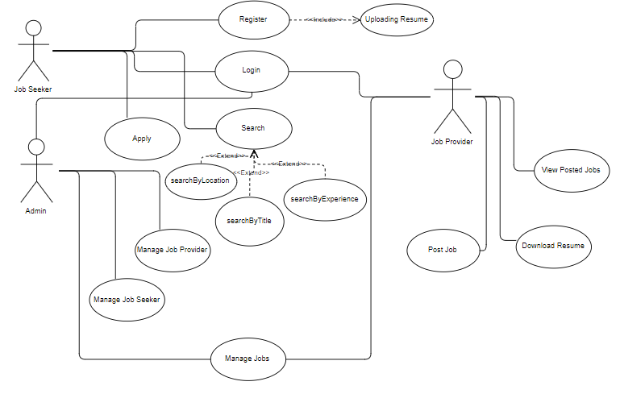
1. Usecase
Diagram

Slide 7
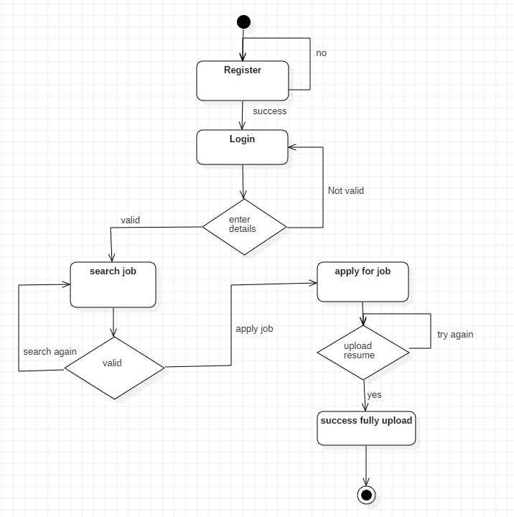
2. ACTIVITY
DIAGRAM
USER

Slide 8
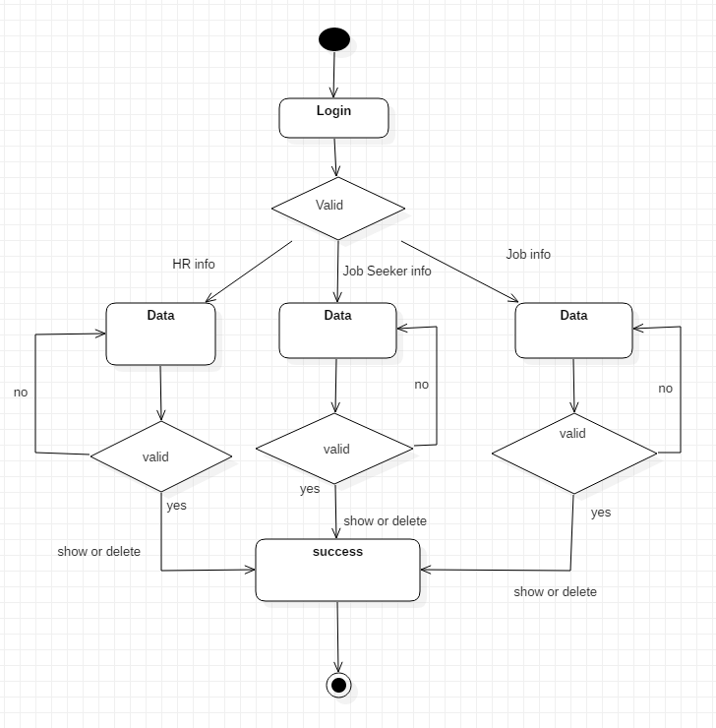
3. ACTIVITY
DIAGRAM
ADMIN

Slide 9
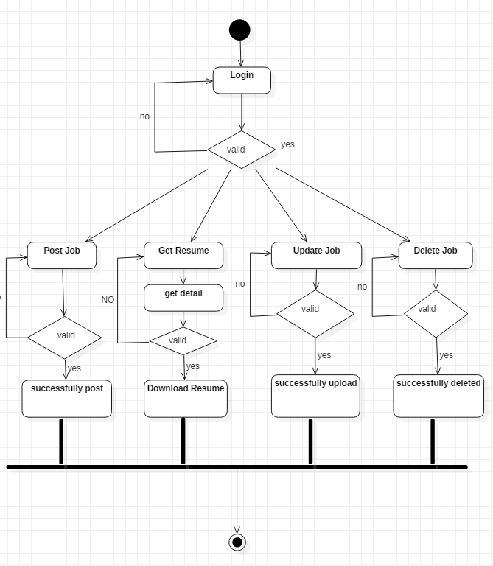
4. ACTIVITY
DIAGRAM
HR

Slide 10
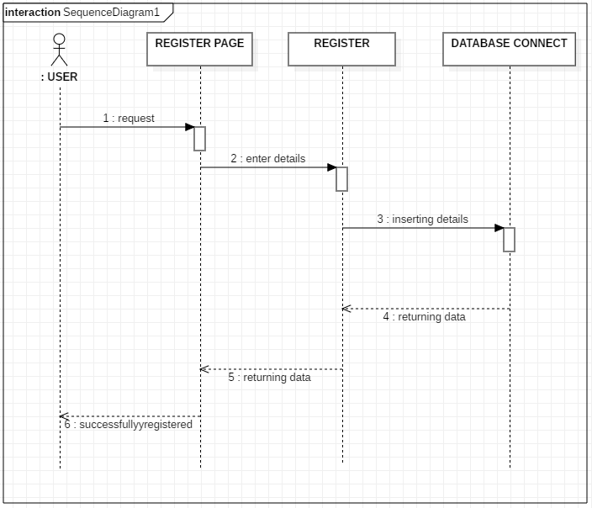
5. SEQUENCE DIAGRAM
(REGISTER)

Slide 11
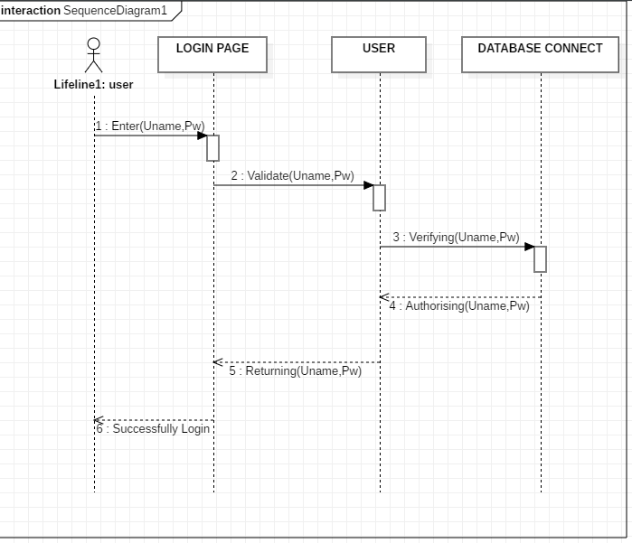
6. SEQUENCE DIAGRAM
(LOGIN)

Slide 12
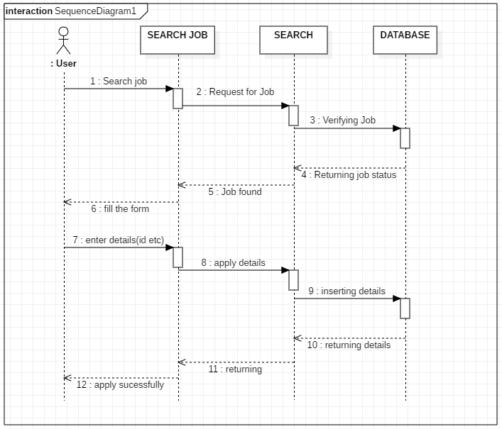
7. SEQUENCE DIAGRAM
(USER)

Slide 13
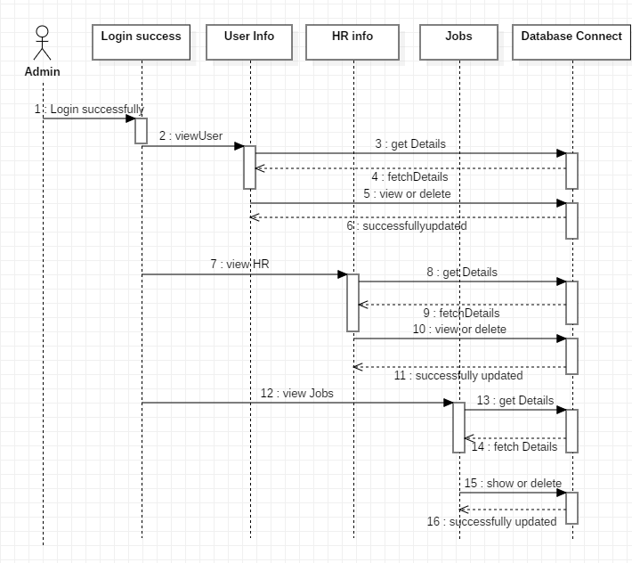
8. SEQUENCE DIAGRAM
(ADMIN)

Slide 14
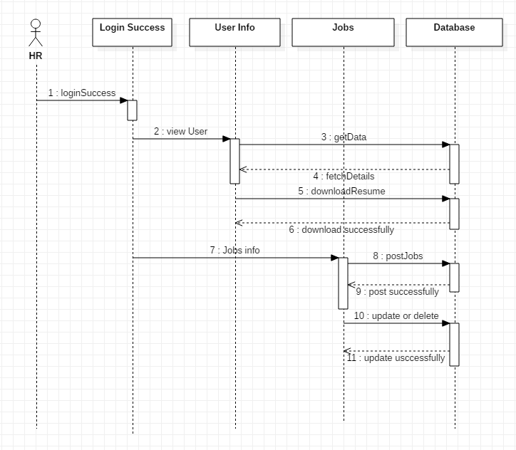
9. SEQUENCE DIAGRAM
(HR)

Slide 15
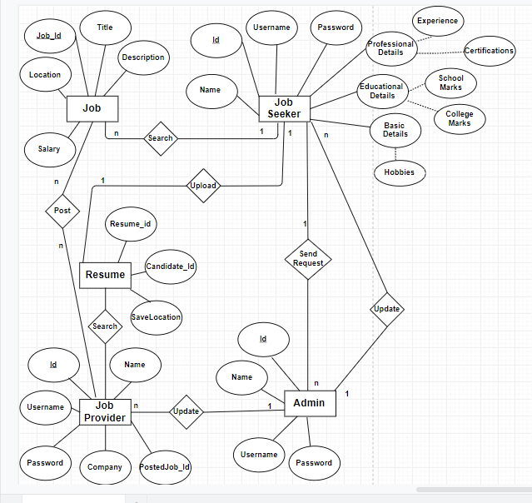
10. ER Diagram

Slide 16
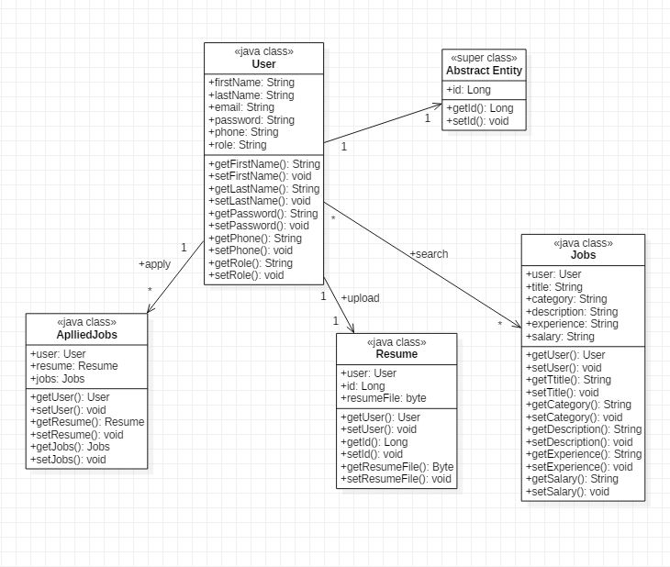
11. Class
Diagram

Slide 17
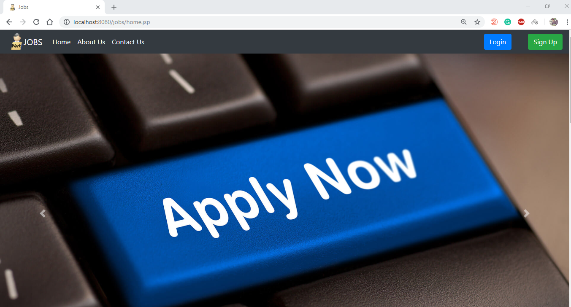
Home Page

Slide 18
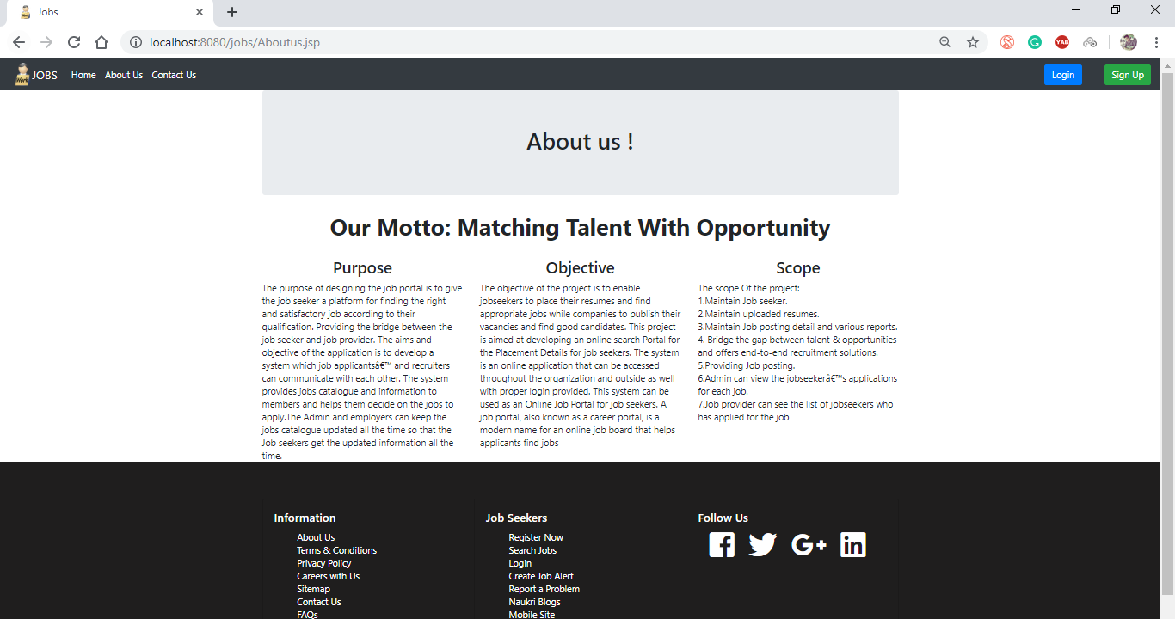
About Us

Slide 19
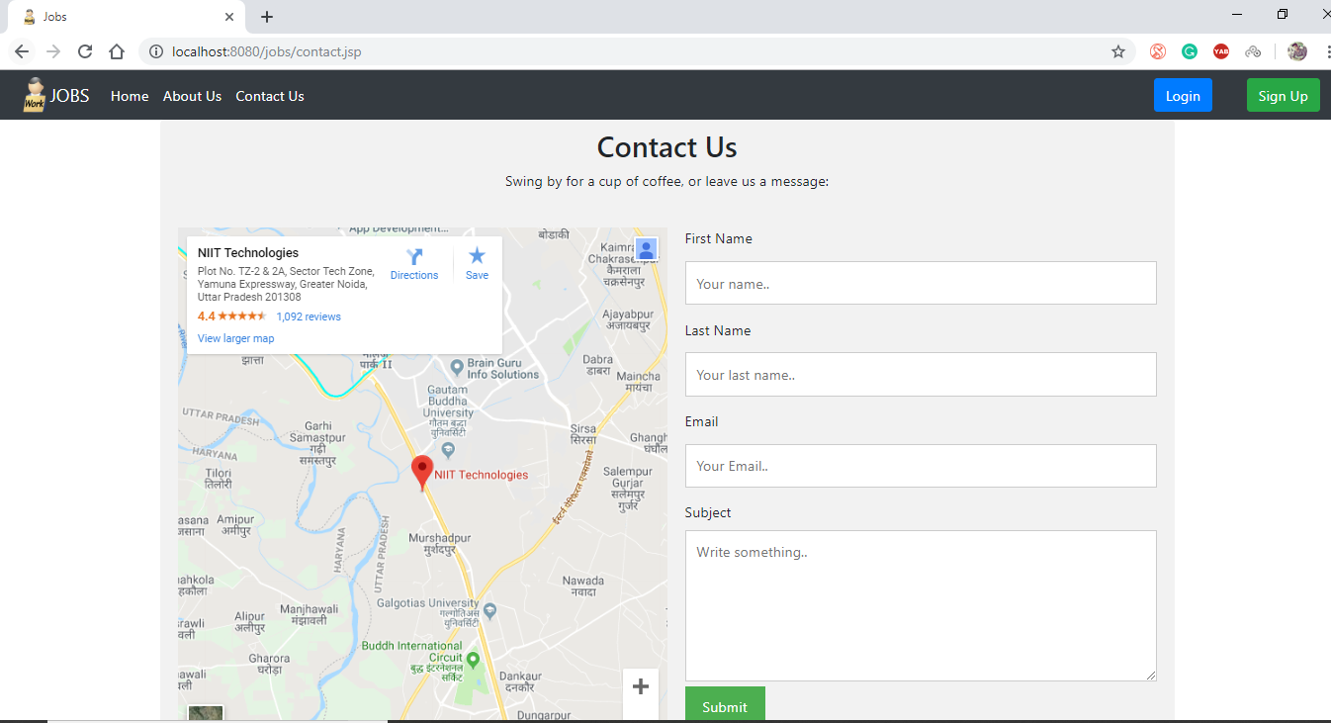
Contact Us

Slide 20
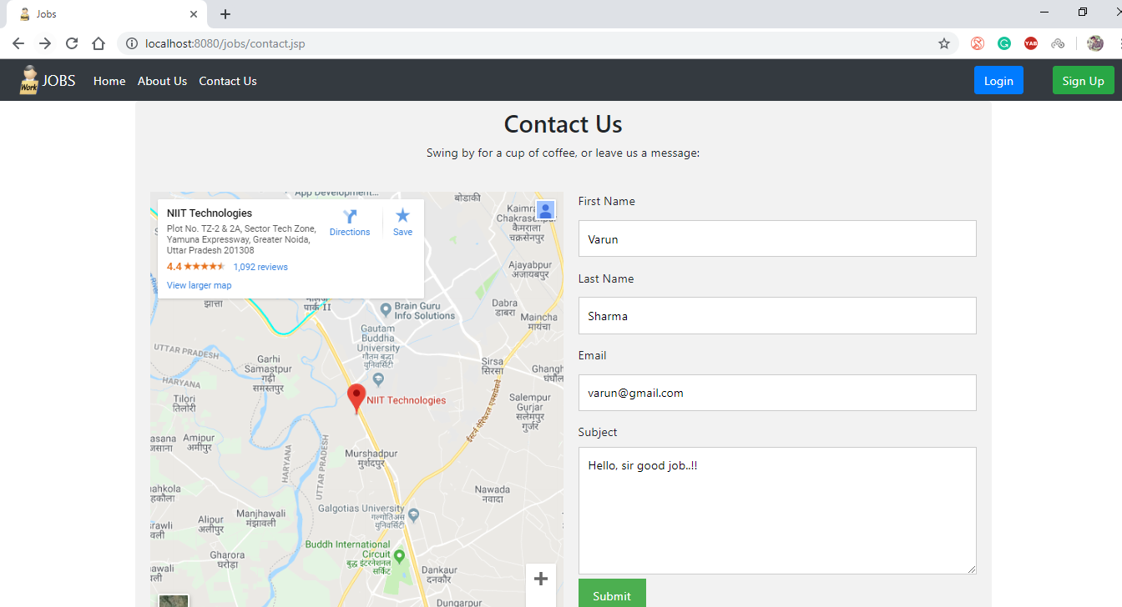
Email to Admin

Slide 21
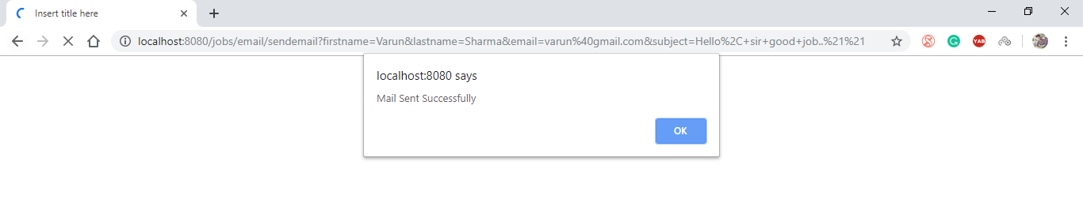
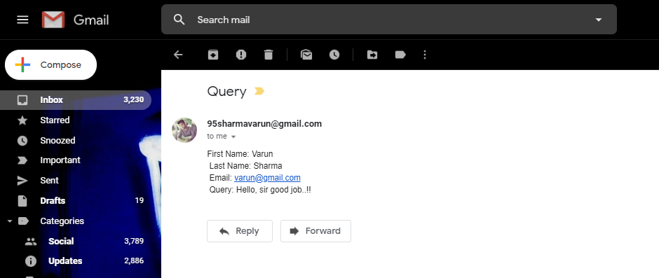

Slide 22
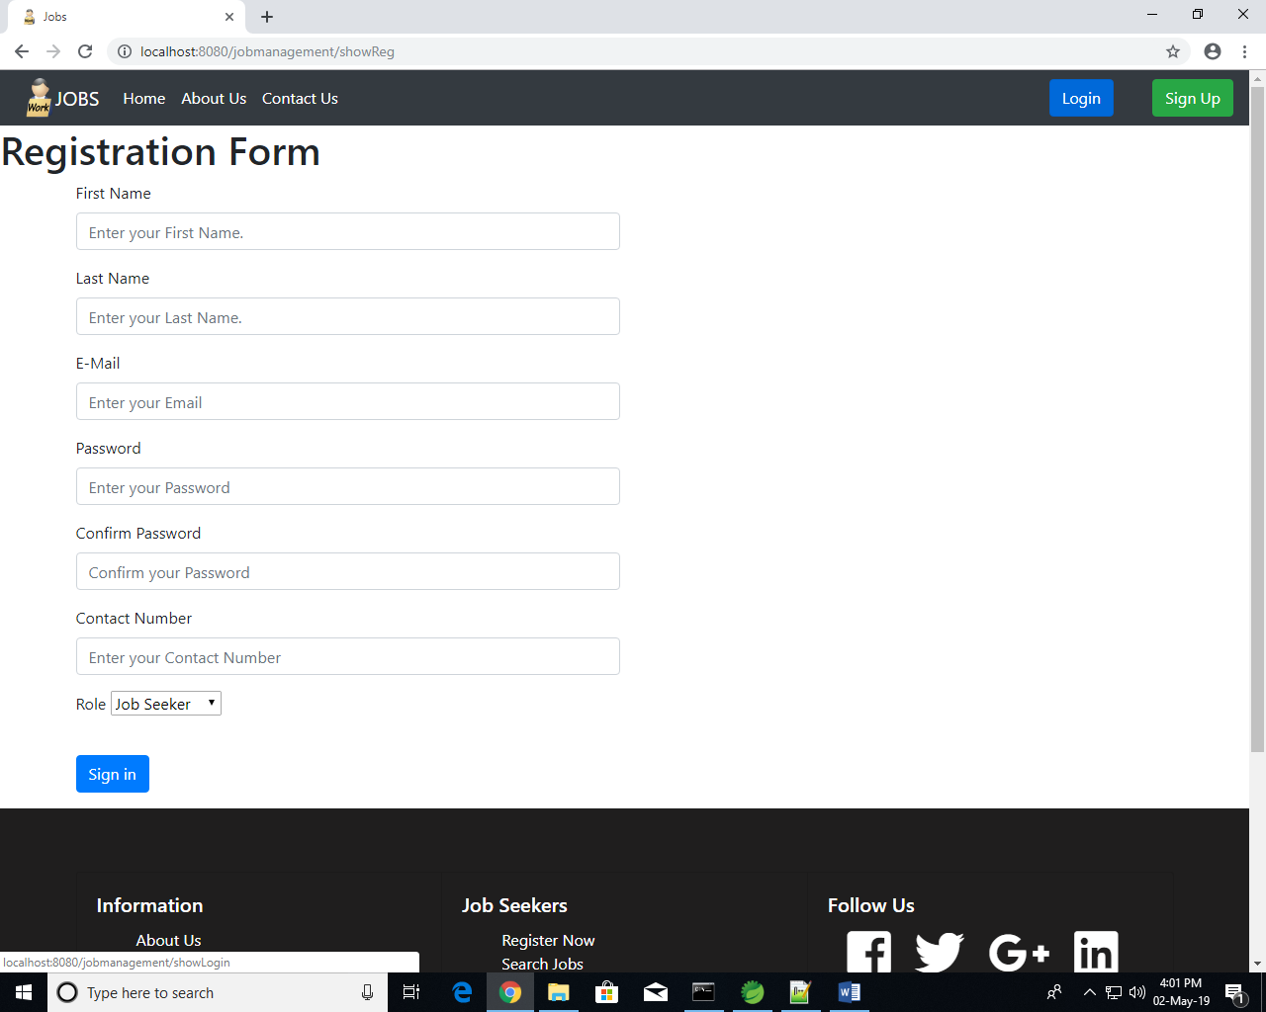
Registration :-

Slide 23
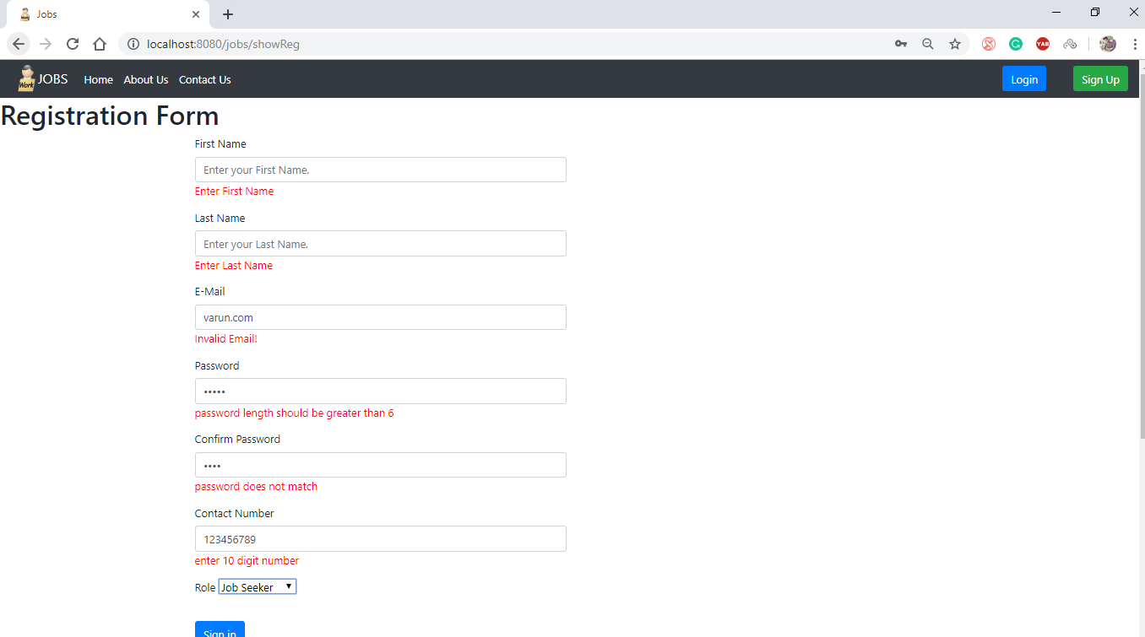

Slide 24
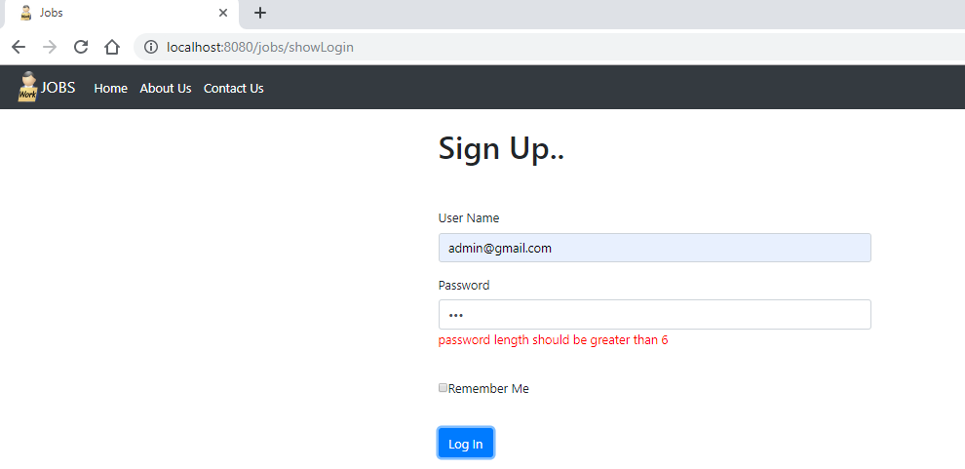
Login As Admin

Slide 25
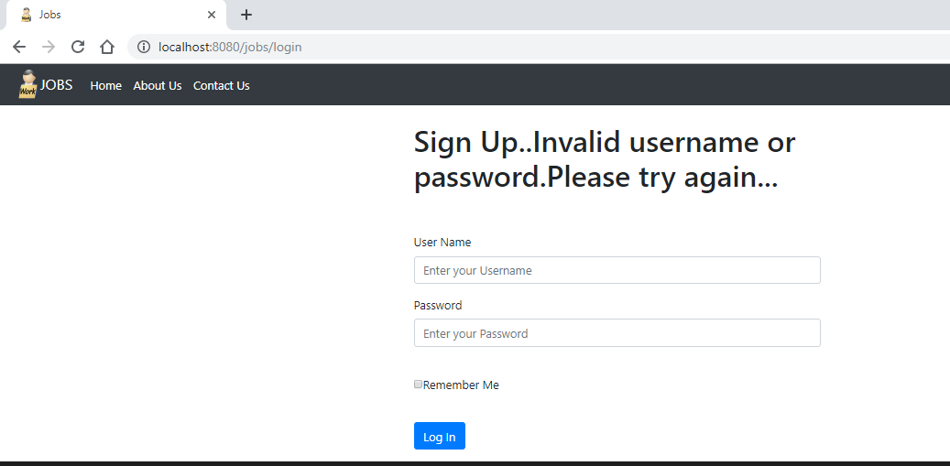
Invalid Credentials

Slide 26
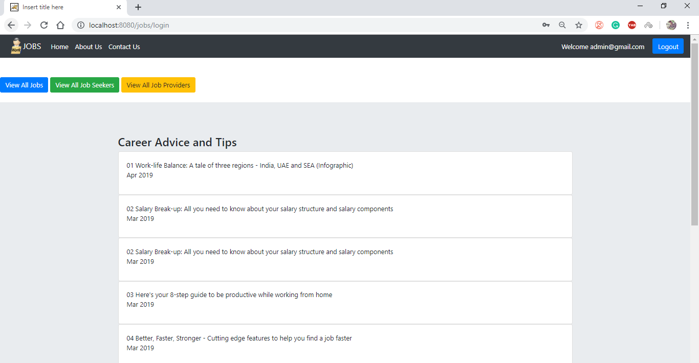
Admin After Successfully Login

Slide 27
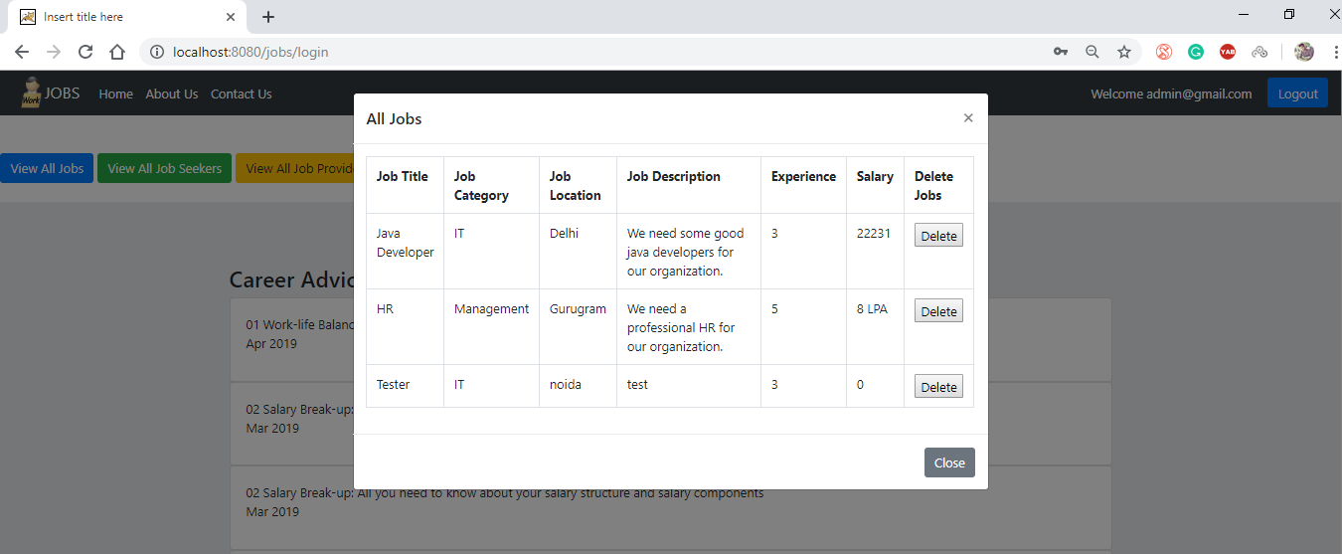
Admin View/Delete All Jobs:-

Slide 28
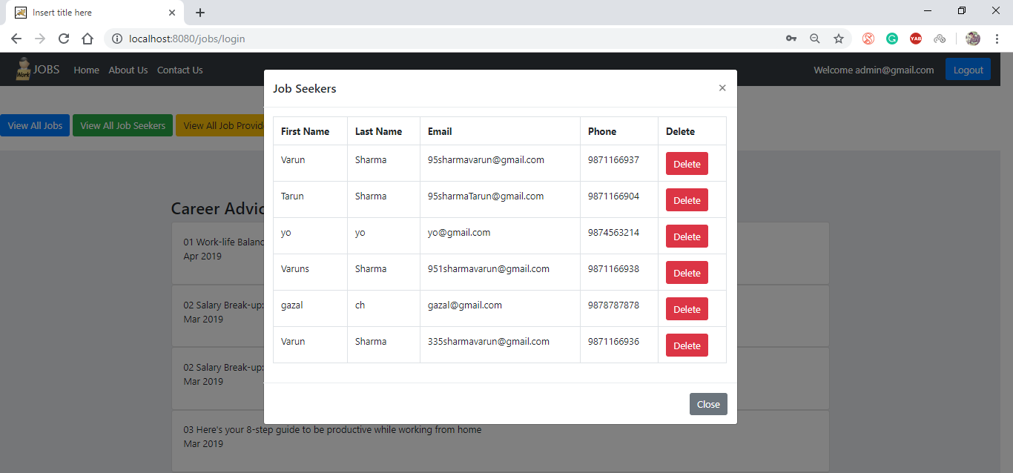
Admin View/Delete All Job Seekers

Slide 29
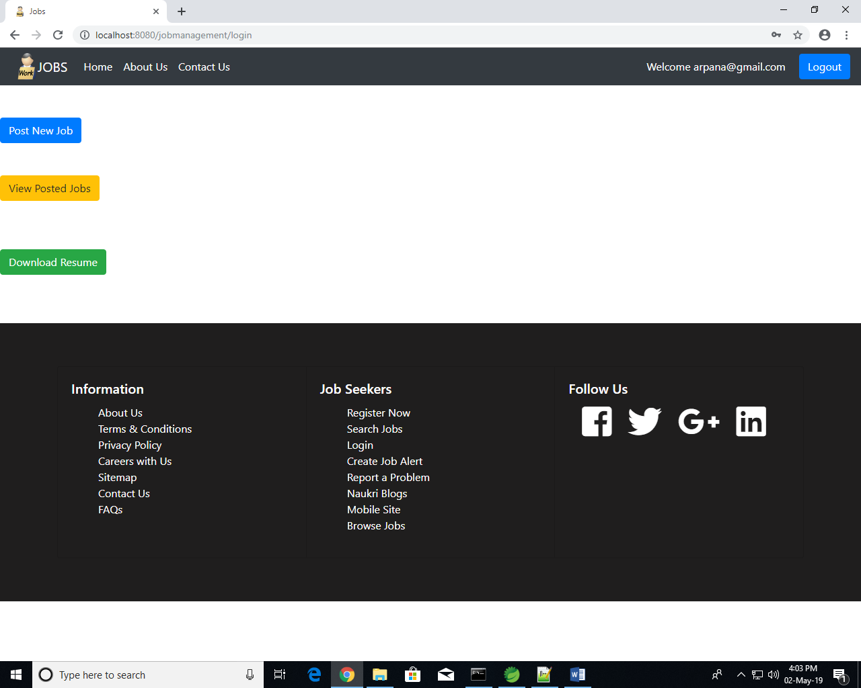
Job Provider :-

Slide 30
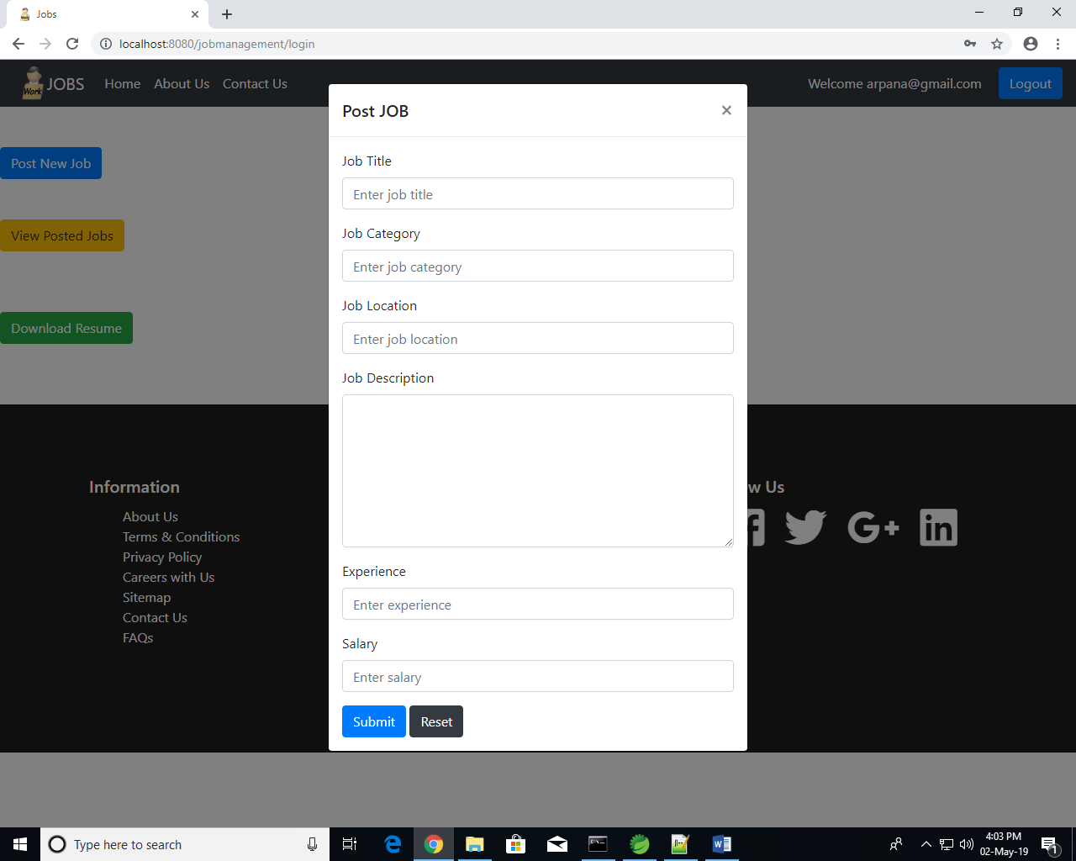
New Job Post

Slide 31
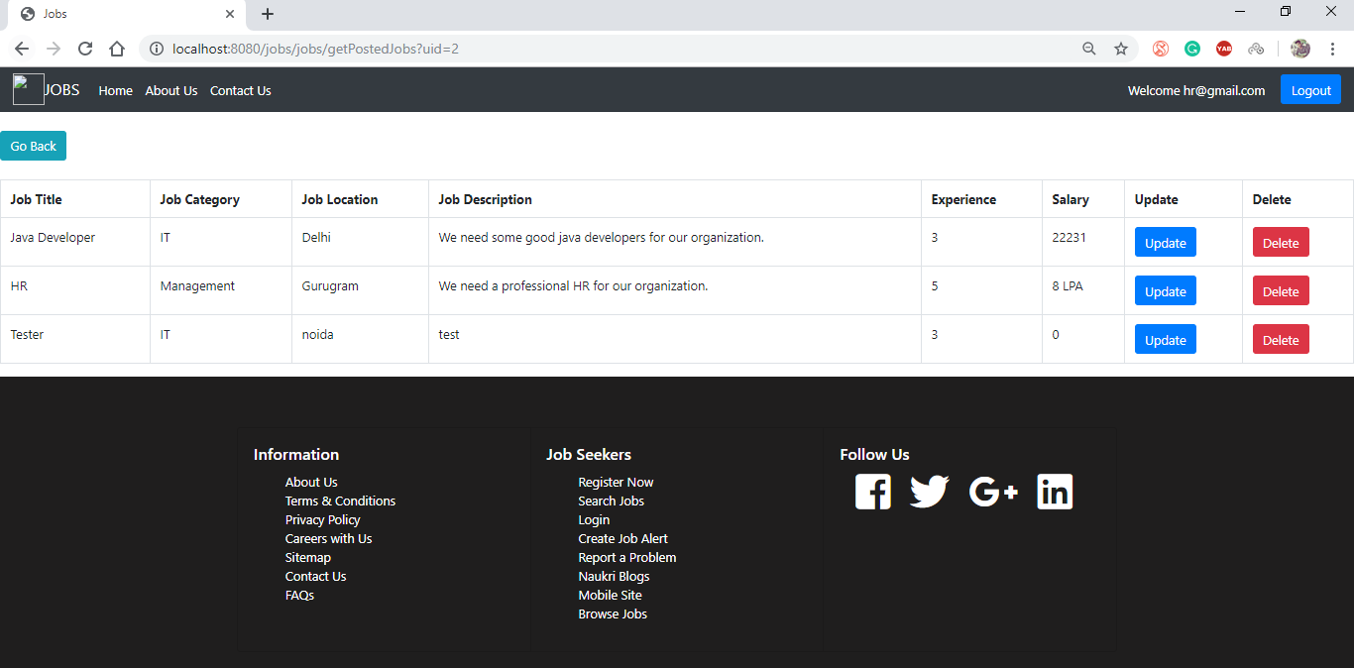
View Posted Jobs

Slide 32
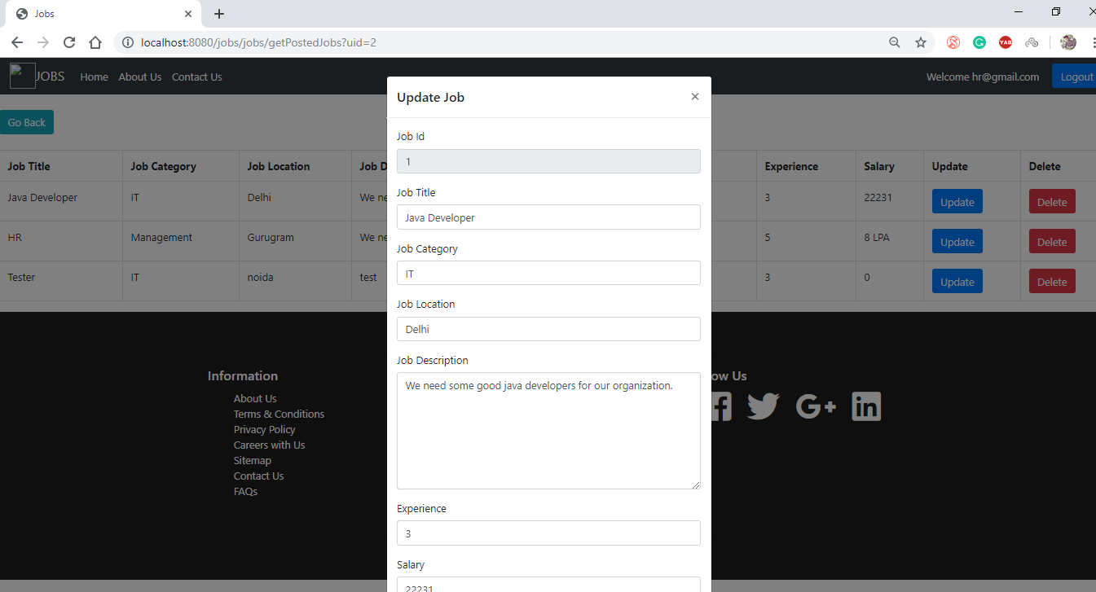
Update Posted Job

Slide 33
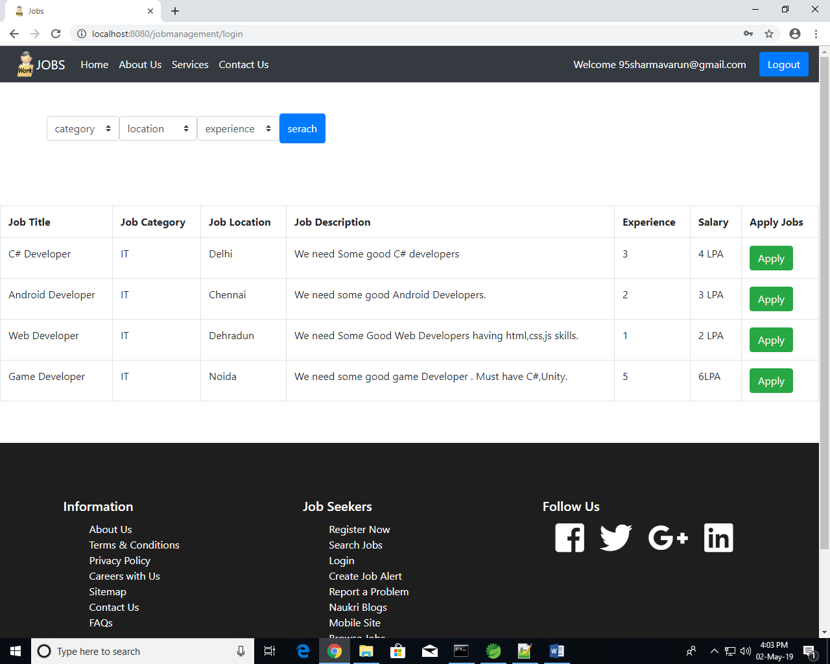
Job Seeker :-

Slide 34
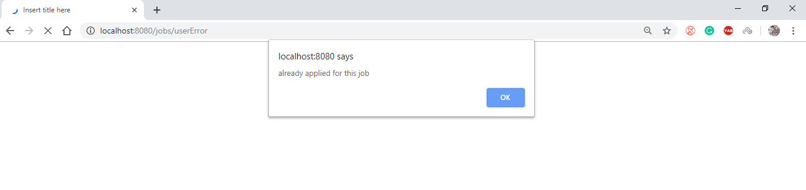
Applying for the same Job

Slide 35
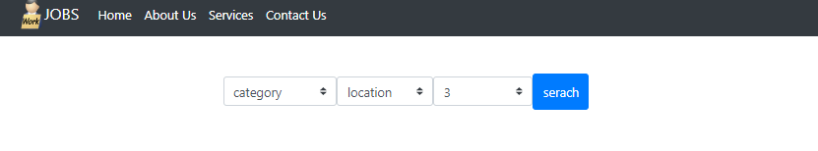
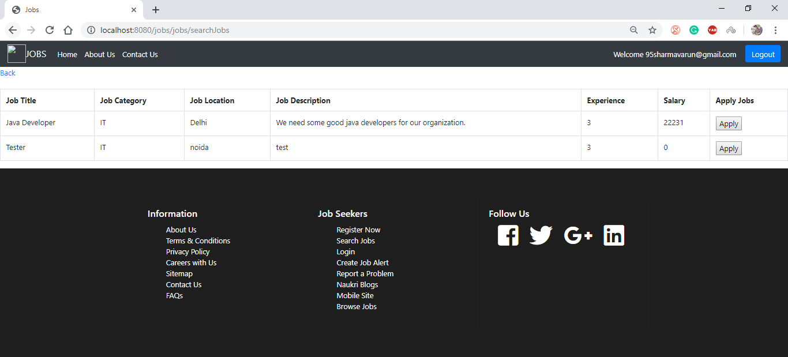
Search

Slide 36
Future Scope
This project fulfils the primary requirements of the job seekers and employers. It can be extended in several ways –
We can provide recommendations and email updates for new job postings based on the job seeker’s search history.
Since, the job seekers might be interested in building a strong Resume, we can provide tips and information for the same.
We can also provide templates for building the Resumes which might interest most applicants. The mobile application is developed fulfilling the functionalities of job seeker, it can be extended to support functionalities of Employer as well.

Slide 37
References
[1] “Overview of Spring Framework” http://docs.spring.io/spring/docs/current/spring-framework-reference/html/index.html[Sep.10, 2016]
[2]“Hibernate Getting Started Guide” https://docs.jboss.org/hibernate/orm/5.0/quickstart/html/ [Sep 15, 2016]
[3]“Hibernate-Architecture” http://www.tutorialspoint.com/hibernate/hibernate_architecture.htm [Sep. 30, 2016]
[4] “The Complete Reference”.
[5] https://stackoverflow.com/questions/29479814/spring-mvc-or-spring-boot

Slide 38

THANK YOU..

